Slide 1
September Update

Slide 2
What I have done

Slide 3
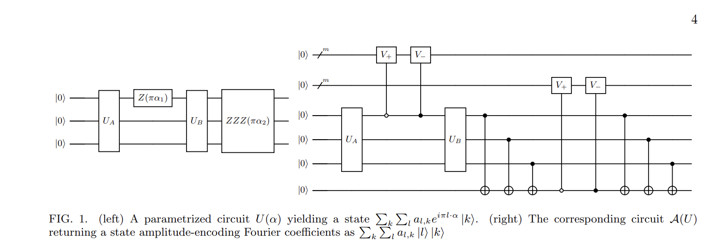
Fourier Coefficient Extraction Algorithm

Slide 4
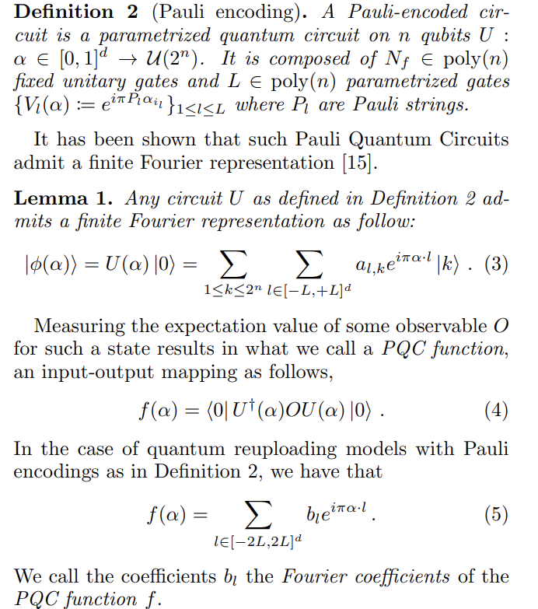
Fourier Coefficient Extraction Algorithm
Definition has Pauli gates
so Fourier transform has as well
Algorithm counts in +-1

Slide 5
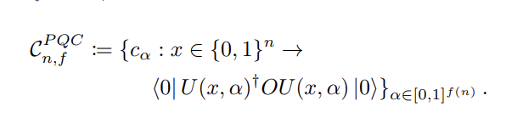
Concept Class
PQC based functions:
  x is a bitstring representing fixed gates

Slide 6

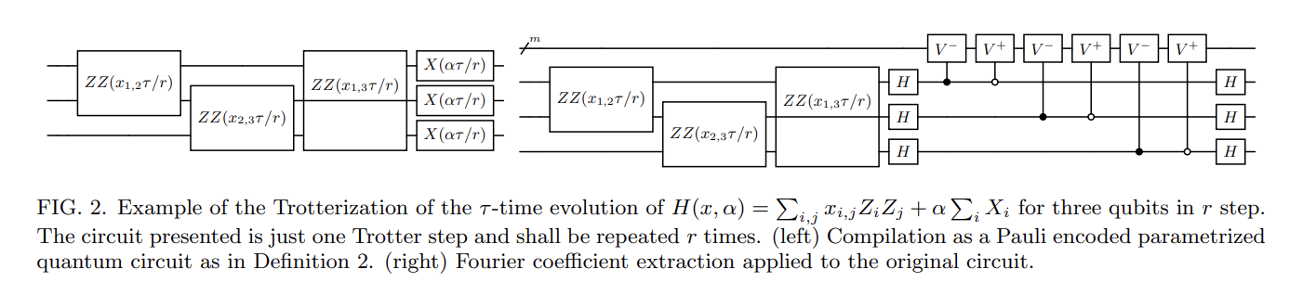
Hamiltonian Dynamics

Slide 7
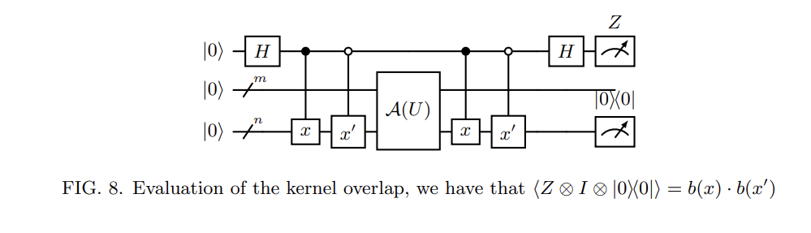
Kernel Method

Slide 8
Things to do
Write code and run
Read about kernels and their properties
Prove correctness of algorithm

